Slide 1

Dissertation Stage – 1 Presentation
Transformer-Driven Visual Question Answering
By
Saurabh Madake
712352023
Guided by
Prof. A. B. Patil
COEP Tech Pune
COEP Technological University
A Unitary Public University of Govt. of Maharashtra
Formerly College of Engineering Pune

Slide 2
Index
Introduction
Literature survey
Research gaps and challenges
Problem statement
Objectives
Architecture
Timeline chart
References
COEP Technological University
A Unitary Public University of Govt. of Maharashtra
Formerly College of Engineering Pune

Slide 3
Introduction
Visual Question Answering (VQA) is a field that bridges computer vision and natural language processing (NLP) to enable machines to understand and respond to questions about visual content.
It is also known as an AI Complete task.
The significance of VQA lies in its potential applications, such as assisting visually impaired individuals, enhancing human computer interactions, etc.
Unlike traditional methods which required a separate pipeline for textual and visual data, recent development in transformers like LXMERT have revolutionize this process.
COEP Technological University
A Unitary Public University of Govt. of Maharashtra
Formerly College of Engineering Pune

Slide 4
Literature Survey
Sr.no | Author Name | Paper Title | Date of publishing | Observations
1 | Tan and Bansal | LXMERT: Learning Cross-Modality Encoder Representations from Transformers | 2019 | Tan and Bansal in 2019 introduced the LXMERT model, demonstrating significant improvements in VQA tasks by effectively integrating visual and textual information. It includes three types of encoders: object-relationship, language, and cross-modality. LXMERT is evaluated on popular datasets such as VQA, GQA, and NLVR2, outperforming previous state-of-the-art methods. This paper highlights LXMERT has superior performance on cross-modality tasks compared to previous BERT-like models, which focus solely on language.
COEP Technological University
A Unitary Public University of Govt. of Maharashtra
Formerly College of Engineering Pune

Slide 5
Sr.no | Author Name | Paper Title | Date of publishing | Observations
2 | Liunian Harold Li et.al | VisualBERT: A Simple Model for Visionand- Language Tasks | 2019 | VisualBERT integrates BERT with image features extracted from object detectors, using Transformers to process text and image inputs. It undergoes task-agnostic pre-training, task-specific pre-training, and fine-tuning for specific tasks. Pre-trained on COCO, it serves as an effective baseline for vision- language tasks, leveraging BERT’s language modeling capabilities.
COEP Technological University
A Unitary Public University of Govt. of Maharashtra
Formerly College of Engineering Pune

Slide 6
Sr.no | Author Name | Paper Title | Date of publishing | Observations
3 | Lu et al. | ViLBERT:pretrainingask-Agnostic Vision-and-Language BERT | 2019 | ViLBERT extends BERT with a two-stream ar- chitecture that processes textual and visual inputs separately and then interacts through co-attentional transformers. Pretrained on Conceptual Captions dataset, it is optimized for vision-language tasks like visual question answering and visual commonsense reasoning, outperforming task-specific models by achieving state-of-the-art results.
COEP Technological University
A Unitary Public University of Govt. of Maharashtra
Formerly College of Engineering Pune

Slide 7
Sr.no | Author Name | Paper Title | Date of publishing | Observations
4 | Kaavya Rekanar et. al | Optimizing Visual Question Answering Models for Driving: Bridging the Gap Between Human and Machine Attention Patterns | 2024 | This paper focuses on the attentional gap between humans and machines in driving scenarios for VQA models. The proposed filter enhances the attention mechanism in LXMERT for driving-specific elements, such as roads and vehicles. The model’s performance improves significantly in driving scenarios by aligning attention more closely with human observation patterns.
COEP Technological University
A Unitary Public University of Govt. of Maharashtra
Formerly College of Engineering Pune

Slide 8
Sr.no | Author Name | Paper Title | Date of publishing | Observations
5 | Zhicheng Huang et. al | Pixel-BERT: Aligning Image Pixels with Text by Deep Multi- Modal Transformers | 2020 | Pixel-BERT introduces a deep multi-modal trans- former architecture to improve alignment between text and image pixels. By using image-sentence pairs, it improves the semantic links between language and visual data beyond region- based features. It achieves state-of-the-art results across several tasks like VQA, showing a 2.17-point improvement compared to previous models.
COEP Technological University
A Unitary Public University of Govt. of Maharashtra
Formerly College of Engineering Pune

Slide 9
Sr.no | Author Name | Paper Title | Date of publishing | Observations
6 | Wang, Jianfeng et. al | Image to Label to An- swer: An Efficient Framework for En- hanced Clinical Appli- cations in Medical Vi- sual Question Answer- ing | 2024 | Med-VQA combines large language models and multi- label learning to address data scarcity and complexity in Medical VQA. The Image to Label to Answer (ITLTA) framework reduces costs, improves interpretability, and enables zero-shot learning. Experiments on the VQA- Med 2019 dataset show that Med-VQA outperforms cur- rent approaches, enabling more effective clinical applications.
COEP Technological University
A Unitary Public University of Govt. of Maharashtra
Formerly College of Engineering Pune

Slide 10
Sr.no | Author Name | Paper Title | Date of Publishing | Observations
7 | Rub’en Tito et. al | Hierarchical multi- modal transform- ers for Multi-Page DocVQA | 2023 | This paper extends Document VQA to multi-page documents with the MP- DocVQA dataset and proposes Hi-VT5, a hierarchical multimodal transformer. Hi-VT5 processes multi-page documents effectively and outperforms existing models in terms of performance and explainability, making it a better fit for real-world applications involving multi-page document contexts.
COEP Technological University
A Unitary Public University of Govt. of Maharashtra
Formerly College of Engineering Pune

Slide 11
Sr.no | Author Name | Paper Title | Date of publishing | Observations
8 | Aisha Urooj Khan et. al | MMFT-BERT: Multi- modal Fusion Trans- former with BERT Encodings for Visual Question Answering | 2020 | In order to tackle the problem of Visual Ques- tion Answering (VQA), the MMFT-BERT model (Multimodal Fusion Transformer with BERT encodings) processes various modalities—text, video, and subtitles—individually and collaboratively. Each modality is given its own BERT encoder, and the outputs are then fused together using a brand-new transformer-based fusion method. On the TVQA dataset, the model performs better than earlier state-of-the-art models, demonstrating gains in accuracy.
COEP Technological University
A Unitary Public University of Govt. of Maharashtra
Formerly College of Engineering Pune

Slide 12
Sr.no | Author Name | Paper Title | Date of publishing | Observations
9 | Wonjae Kim et.al | ViLT: Vision and Lan- guage Transformer Without Convolution or Region Supervision | 2021 | A vision-language pretraining paradigm called ViLT (Vision and Language Transformer) removes the requirement for region supervision and convolutional neural networks (CNNs) to streamline visual processing. ViLT embeds picture patches using a linear projection, in contrast to typical models that rely on object detectors and CNNs for image feature extraction. This architecture maintains competitive performance across vision-language tasks such as VQAv2 and image retrieval, while reducing computational complexity to make it up to ten times faster than previous models.
COEP Technological University
A Unitary Public University of Govt. of Maharashtra
Formerly College of Engineering Pune

Slide 13
Sr.no | Author Name | Paper Title | Date of publishing | Observations
10 | Tim Siebert et. al | Multi-Modal Fu- sion Transformer for Visual Question Answering in Remote Sensing | 2022 | The paper presents a new architecture for visual question answering (VQA) in remote sensing (RS) called VBFusion, which jointly learns image and text representations by using multi- modal transformer models. By utilizing a feature extraction module, a fusion module that combines multiple VisualBERT layers, and a classification module, this approach overcomes the limitations of existing models and can handle complex, non-specific questions that go beyond predefined object categories.
COEP Technological University
A Unitary Public University of Govt. of Maharashtra
Formerly College of Engineering Pune

Slide 14
Sr.no | Author Name | Paper Title | Date of publishing | Observations
11 | Jinmeng Wu et. al | Question-Driven Multiple Attention (DQMA) Model for Visual Question Answer | 2022 | The Question-Driven Multiple Attention (DQMA) model is proposed in this paper. It deals with the problem of extraneous visual information influencing VQA models accuracy. The DQMA model uses LSTM for question features and Faster R-CNN for image feature extraction. Relevant image regions are chosen by a question-driven attention mechanism, which lowers noise. In order to improve the interaction between the question and image features, the model also incorporates coattention networks. Assessments conducted on the VQA 2.0 dataset reveal that the DQMA model surpasses alternative techniques, enhancing overall precision.
COEP Technological University
A Unitary Public University of Govt. of Maharashtra
Formerly College of Engineering Pune

Slide 15
Sr.no | Author Name | Paper Title | Date of publishing | Observations
12 | Zekai Shao et. al | Visual Explanation for Open-Domain Question Answering With BERT | 2024 | In order to clarify the decision-making process in Open-Domain Question Answering (OpenQA) models, especially those that use BERT, the paper suggests VEQA, a visual analytics system. OpenQA addresses issues with complicated data and models while providing answers to queries derived from lengthy unstructured text passages. In order to address these, VEQA provides visual explanations at three different levels: summary, instance, and module. This enables experts to examine the way in which models handle questions and extract pertinent passages. By using visual aids such as ranking visualizations and compara- tive trees, VEQA enhances the interpretability of models and identifies areas that
COEP Technological University
A Unitary Public University of Govt. of Maharashtra
Formerly College of Engineering Pune

Slide 16
Sr.no | Author Name | Paper Title | Date of publishing | Observations
13 | Sahithya Ravi et. al | VLC-BERT: Visual Question Answering with Contextual- ized Commonsense Knowledge | 2023 | The VLC-BERT model is designed for Visual Question Answering (VQA) with an emphasis on common- sense reasoning. It incorporates contextualized knowledge using the COMET model, which is trained on human-curated knowledge bases like ConceptNet and ATOMIC. The model combines visual and textual inputs with commonsense inferences to answer ques- tions that require reasoning beyond what is visible in the image. Through attention mechanisms, VLC- BERT selects the most relevant commonsense knowledge to enhance the VQA task.
COEP Technological University
A Unitary Public University of Govt. of Maharashtra
Formerly College of Engineering Pune

Slide 17
Sr.no | Author Name | Paper Title | Date of publishing | Observations
14 | Dhiraj Amin et. al | Visual Question An- swering System for In- dian Regional Lan- guages | 2022 | The paper ”Visual Question Answering System for Indian Regional Languages” addresses the scarcity of datasets for Indian languages like Hindi and Marathi in visual question answering (VQA) systems. The authors investigate the adaptation of the easy-VQA dataset for these languages, developing models that integrate natural language processing and computer vision to answer questions based on images. Various architectures, including CNNs and RNNs like LSTM, are explored for handling both image and text inputs. The paper demonstrates how translated datasets and deep learning techniques can bridge the gap for regional language VQA tasks
COEP Technological University
A Unitary Public University of Govt. of Maharashtra
Formerly College of Engineering Pune

Slide 18
Sr.no | Author Name | Paper Title | Date of publishing | Observations
15 | Venkat Kodali et. al | Recent, Rapid Ad- vancement in Visual Question Answering: a Review | 2022 | The paper ”Recent, Rapid Advancement in Visual Question Answering: a Review” provides a detailed overview of the rapid developments in Visual Question Answering (VQA). It highlights how VQA, combining computer vision and nat- ural language processing, has grown exponentially in research output since 2015. The review covers key VQA models and techniques, including attention-based and transformer architectures, particularly BERT, which have revolutionized VQA performance. It also discusses medical image datasets and their unique VQA challenges, such as data scarcity, and offers suggestions for future research directions.
COEP Technological University
A Unitary Public University of Govt. of Maharashtra
Formerly College of Engineering Pune

Slide 19
Research gaps and challenges
Dataset Limitations
While datasets like VQA v2.0 and Visual Genome provide extensive annotations, they still have limitations in diversity and complexity. Many existing datasets lack sufficient diversity in visual scenes and question types, which can lead to overfitting and reduced generalization in real-world applications.
Model Generalizability
Transformer-based models, despite their impressive performance, often struggle with generalizing to unseen data or adapting to different domains. Ensuring that VQA models maintain high accuracy across diverse scenarios remains a significant challenge.
Computational Constraints
Training large transformer models requires substantial computational resources, which can be a barrier for researchers with limited access to high-performance hardware. Additionally, deploying these models in resource-constrained environments poses challenges related to efficiency and latency.
COEP Technological University
A Unitary Public University of Govt. of Maharashtra
Formerly College of Engineering Pune

Slide 20
Problem statement
Transformer-Driven Visual Question Answering
This dissertation aims to develop a transformer-based VQA system that improves the interpretability and accuracy of responses by fusing image and textual representations more effectively.
COEP Technological University
A Unitary Public University of Govt. of Maharashtra
Formerly College of Engineering Pune

Slide 21
Objectives
To enhance the capabilities of visual question answering (VQA) systems
Improving their accuracy and efficiency through the exploration of advanced multimodal transformer architectures, while providing insights and guidelines for handling multimodal data that can inform future research in VQA and related fields
To investigate the impact of combining VQA v2.0 with Visual Genome data, specifically focusing on how enriched object relationships and attributes from Visual Genome improve question-answering performance.
To evaluate the performance of the LXMERT model on the both dataset and compare it with other baseline models in terms of accuracy and efficiency.
COEP Technological University
A Unitary Public University of Govt. of Maharashtra
Formerly College of Engineering Pune

Slide 22
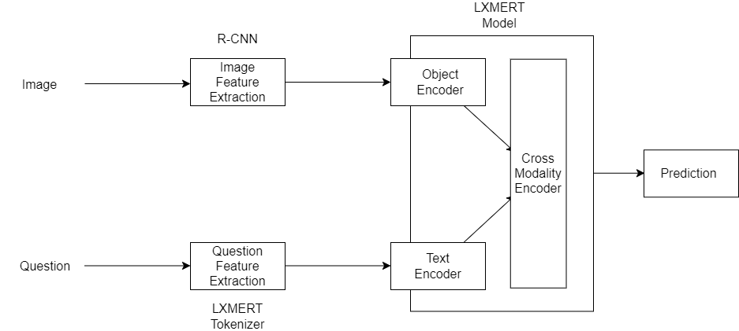
Architecture
COEP Technological University
A Unitary Public University of Govt. of Maharashtra
Formerly College of Engineering Pune

Slide 23
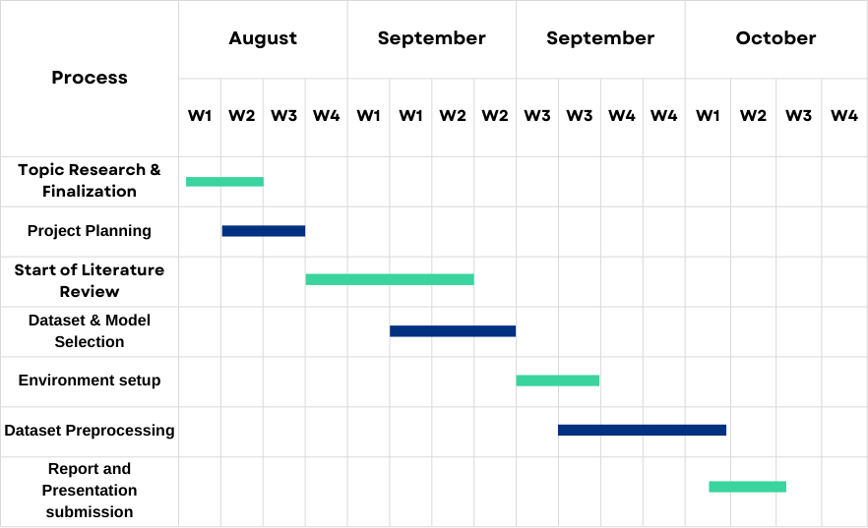
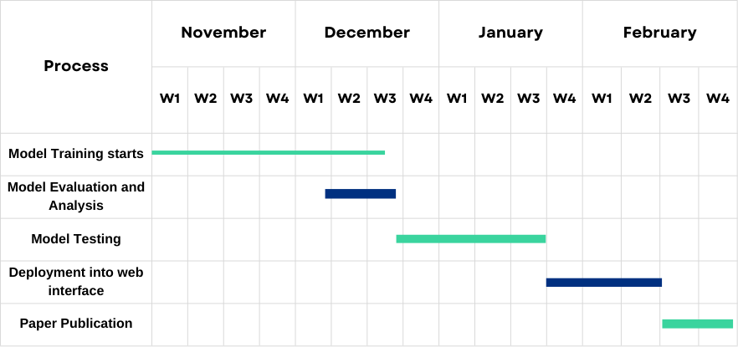
Timeline
COEP Technological University
A Unitary Public University of Govt. of Maharashtra
Formerly College of Engineering Pune

Slide 24
References:
Tan, H. and Bansal, M., 2019. Lxmert: Learning cross-modality encoder representations from transformers. arXiv preprint arXiv:1908.07490.
Li, L.H., Yatskar, M., Yin, D., Hsieh, C.J. and Chang, K.W., 2019. Visualbert: A simple and performant baseline for vision and language. arXiv preprint arXiv:1908.03557.
Lu, J., Batra, D., Parikh, D. and Lee, S., 2019. Vilbert: Pretraining task-agnostic visiolinguistic representations for vision-and-language tasks. Advances in neural information processing systems, 32.
Rekanar, K., Hayes, M., Sistu, G. and Eising, C., 2024. Optimizing Visual Question Answering Models for Driving: Bridging the Gap Between Human and Machine Attention Patterns. arXiv preprint arXiv:2406.09203.
Huang, Z., Zeng, Z., Liu, B., Fu, D. and Fu, J., 2020. Pixel-bert: Aligning image pixels with text by deep multi-modal transformers. arXiv preprint arXiv:2004.00849.
Wang, Jianfeng & Seng, Kah & Shen, Yi & Ang, Li-Minn & Huang, Difeng. (2024). Image to Label to Answer: An Efficient Framework for Enhanced Clinical Applications in Medical Visual Question Answering. Electronics. 13. 2273. 10.3390/electronics13122273.
Tito, R., Karatzas, D. and Valveny, E., 2023. Hierarchical multimodal transformers for multipage docvqa. Pattern Recognition, 144, p.109834.
COEP Technological University
A Unitary Public University of Govt. of Maharashtra
Formerly College of Engineering Pune

Slide 25
Khan, A.U., Mazaheri, A., Lobo, N.D.V. and Shah, M., 2020. Mmft-bert: Multimodal fusion transformer with bert encodings for visual question answering. arXiv preprint arXiv:2010.14095.
Kim, W., Son, B. and Kim, I., 2021, July. Vilt: Vision-and-language transformer without convolution or region supervision. In International conference on machine learning (pp. 5583-5594). PMLR.
Siebert, T., Clasen, K.N., Ravanbakhsh, M. and Demir, B., 2022, October. Multi-modal fusion transformer for visual question answering in remote sensing. In Image and Signal Processing for Remote Sensing XXVIII (Vol. 12267, pp. 162-170). SPIE.
J. Wu, F. Ge, P. Shu, L. Ma and Y. Hao, "Question-Driven Multiple Attention(DQMA) Model for Visual Question Answer," 2022 International Conference on Artificial Intelligence and Computer Information Technology (AICIT), Yichang, China, 2022, pp. 1-4, doi: 10.1109/AICIT55386.2022.9930294.
Z. Shao et al., "Visual Explanation for Open-Domain Question Answering With BERT," in IEEE Transactions on Visualization and Computer Graphics, vol. 30, no. 7, pp. 3779-3797, July 2024, doi: 10.1109/TVCG.2023.3243676.
S. Ravi, A. Chinchure, L. Sigal, R. Liao and V. Shwartz, "VLC-BERT: Visual Question Answering with Contextualized Commonsense Knowledge," 2023 IEEE/CVF Winter Conference on Applications of Computer Vision (WACV), Waikoloa, HI, USA, 2023, pp. 1155-1165, doi: 10.1109/WACV56688.2023.00121.
D. Amin, S. Govilkar and S. Kulkarni, "Visual Question Answering System for Indian Regional Languages," 2022 5th International Conference on Advances in Science and Technology (ICAST), Mumbai, India, 2022, pp. 22-27, doi: 10.1109/ICAST55766.2022.10039528.
COEP Technological University
A Unitary Public University of Govt. of Maharashtra
Formerly College of Engineering Pune

Slide 26
Kodali, V. and Berleant, D., 2022, May. Recent, rapid advancement in visual question answering: a review. In 2022 IEEE International Conference on Electro Information Technology (eIT) (pp. 139-146). IEEE.
Chen, Y.C., Li, L., Yu, L., El Kholy, A., Ahmed, F., Gan, Z., Cheng, Y. and Liu, J., 2020, August. Uniter: Universal image-text representation learning. In European conference on computer vision (pp. 104-120). Cham: Springer International Publishing.
Kim, W., Son, B. and Kim, I., 2021, July. Vilt: Vision-and-language transformer without convolution or region supervision. In International conference on machine learning (pp. 5583-5594). PMLR
COEP Technological University
A Unitary Public University of Govt. of Maharashtra
Formerly College of Engineering Pune

Slide 27
THANK YOU !
COEP Technological University
A Unitary Public University of Govt. of Maharashtra
Formerly College of Engineering Pune

